Slide 1
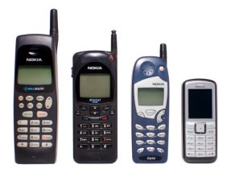
5. Industry Analysis and Competitive Advantage
Vendors
Huge growth in equipment and applications
1M to 1B in 2 years
Operators
Market-by-market battles for market share are raging
1st
How can we assess the attractiveness of an industry?
2nd
3rd
4th
Britain’s auction in early 2000 of 3G licenses wound up raising some $35 billion in license fees, roughly 10 times what was expected
How can we determine how quickly our innovation is likely to win market acceptance?
What does the overall attractiveness of the market and industry context imply for chances for future success?
Finally, how can we establish and then sustain competitive advantage over the duration of our product’s life cycle?

Slide 2
5.1 Markets and Industries: What’s the Difference?
Student Snack market
Products industries
Salty Snacks
Fresh Fruits
Distribution Industries
Supermarkets
Coin machines
Individuals and organisations who are interested and willing to buy a good or service to obtain benefits that will satisfy a particular need or want and who have the resources to engage in such a transaction
Group of firms that offer a product or class of products that are similar and are close substitutes for one another

Slide 3
5.1.1 Defining Markets and Industries: Levels of Analysis
Generic category
Product class
Product type
Product type
Product class
Product type

Slide 4
5.1.2 Challenges in Market and Industry Definition
?
Which level of analysis is preferred?
Category
Fast food, very generic and could contain competing products
Type
Some products could be overlooked, such as McDonalds Thru
So
Customer Needs, use what ever address it, mainly product type

Slide 5
5.2 The Market Is Attractive: What About the Industry?
Attractiveness
Driving forces
Critical success factors
Perform on these factors

Slide 6
5.2.1 Driving Forces
Environment Driving Forces
Changes in Long-term growth rate
Changes in Key buyer segments
Changes in Diffusion of proprietary knowledge
Changes in cost and efficiency
changes in government regulations

Slide 7
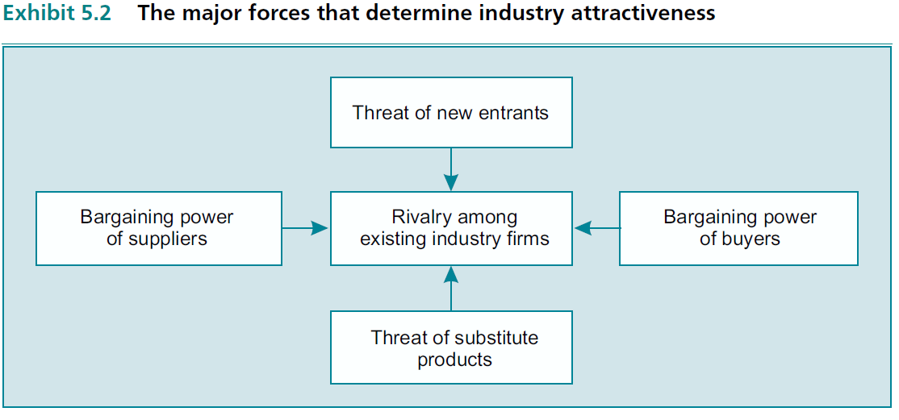
5.2.2 Porter’s Five Competitive Forces

Slide 8
5.2.2.1 Rivalry among Present Competitors
Rivalry
High investment intensity
No dominant firms exist
Little product differentiation
Easy for customers to switch

Slide 9
5.2.2.2 Threat of New Entrants
New entrants
Strong economies of scale and learning
Industry has strong capital requirements
Strong product differentiation
Distribution is particularly difficult

Slide 10
5.2.2.3 Bargaining Power of Suppliers
Suppliers’ Power
Limited number of suppliers
High switching costs
They can threaten forward integration
Supplier’s product is a large part of the buyer’s value added

Slide 11
5.2.2.4 Bargaining Power of Buyers
Buyers’ Power
Buyer concentration
Switching costs
Buyer profitability (The lower the more aggressive)
The threat of backward integration
The product’s importance to the performance of the buyer’s product

Slide 12
5.2.2.5 Threat of Substitute Products
Product
Mobiles
Plastic Bottles
Substitute
I-Pad
Butter
Metal Cans
Margarine
Price Limitation

Slide 13
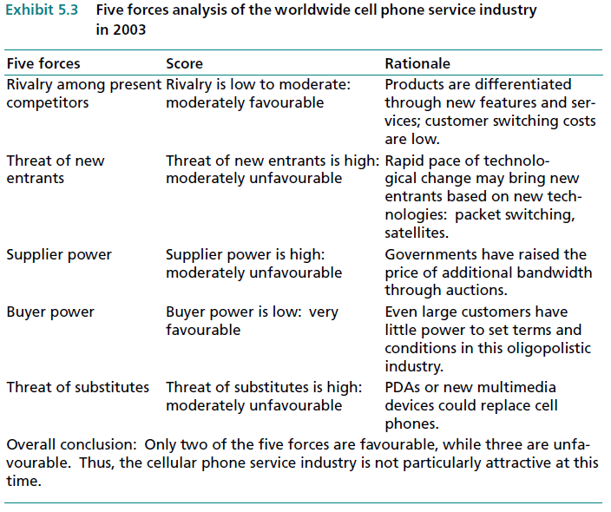
5.2.3 A Five Forces Analysis of the Cellular Phone Service Industry

Slide 14
5.2.4 Changing Competition and Industry Evolution

Slide 15
5.2.5 Critical Success Factors: Who Wins Within an Industry?
Product
What is the product and its features
Place
Location, it is the most important factor
Price
Depends on the demand, costs, competition … etc.
Promotion
How to attract customers

Slide 16
5.3 Industry Analysis Locally: How Intense Is the Immediate Competition?
Industry Analysis should be done locally and globally, and on at the product class and product type level
SCIP Code of Ethics for CI Professionals
Respect of the profession.
comply with all applicable laws, domestic and international.
Disclose all relevant information, including one’s identity and organisation, prior to all interviews.
Respect all requests for confidentiality of information.
Avoid conflicts of interest in fulfilling one’s duties.
Provide honest and realistic recommendations and conclusions in the execution of one’s duties.
Promote this code of ethics within one’s company, with third-party contractors, and within the entire profession.
Adhere to and abide by one’s company policies, objectives, and guidelines.

Slide 17
5.4 Rate of Diffusion of Innovations: Another Factor in Assessing Opportunity Attractiveness
Innovation
Customer adoption
More attractive

Slide 18
5.4.1 The Adoption Process
Awareness
Heard of it
Adoption
One of my preferred
Evaluation
Mental rehearsal
Trial
Actual usage on limited scale
Interest
Only interested not yet involved

Slide 19
5.4.2 The Rate of Adoption
T
T= f(Cost of failure, advantage over other products, simplicity of the new product, compatibility with previously adopted ideas, if it could be accomplished on a small-scale basis; ease of idea communication)

Slide 20
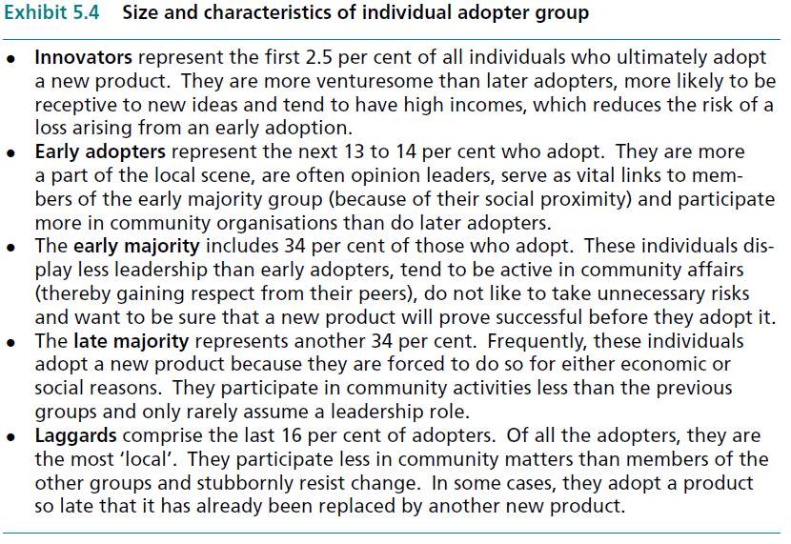
5.4.3 Adopter Categories

Slide 21
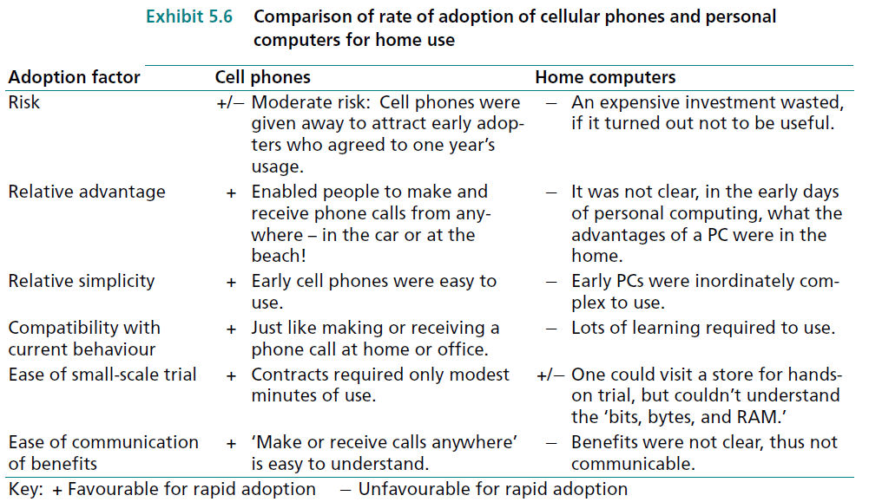
5.4.4 Implications of Diffusion of Innovation Theory for Forecasting Sales of New Products and New Firms
Historically; More typically, first-year penetration levels include some but not all of the innovators

Slide 22
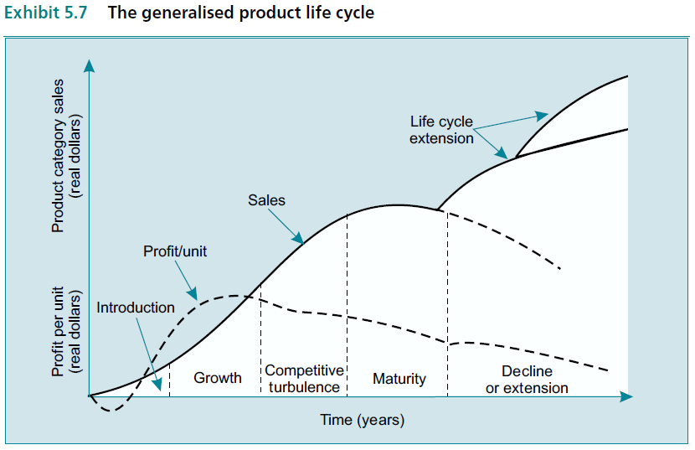
5.5 Sustaining Competitive Advantage over the Product Life Cycle

Slide 23
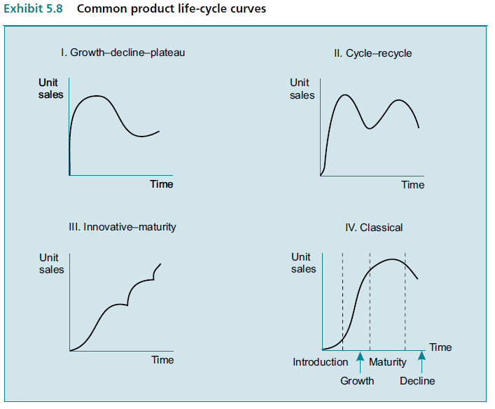
5.5.1 Life Cycle Curves

Slide 24
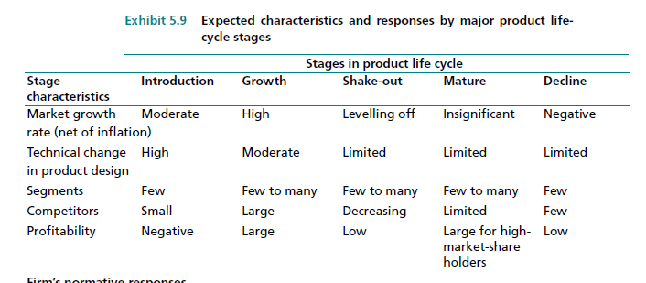
5.5.2 Market and Competitive Implications of Product Life Cycle Stages

Slide 25
5.5.2.1 Marketing Mix Decisions in the Introductory Stage
Introduction
Product
Differentiated: Many early PCs were just bought to do spread sheets on
Price
Skimming: get the best at the beginning
Penetration: for strong competition
Place
Case by case: Distribution is easier to obtain if the company enjoys established channels
Promotion
Advertising and sales-force: High expenditure, more sales for industrial goods

Slide 26
5.5.2.2 Marketing Mix Decisions in the Growth Stage
Growth
Product
Product line expansion: Array of prices and different product features
Price
Declining: f(cost–volume relationships, industry concentration, and the volatility of raw material costs)
Place
Intensive: Main concern is to build strong distribution channels
Promotion
Selective demand: creating demands for the brand instead of the product class (primary demand)

Slide 27
5.5.2.3 Marketing Mix Decisions in the Shakeout Stage
Shake-out
Product
Rationalise: Eliminating weaker items,, and
Price
Rationalise: Emphasises creative promotional pricing
Place
Rationalise: Strengthen its channel relationships
Promotion
Rationalise: Emphasise creative promotional pricing

Slide 28
5.5.2.4 Marketing Mix Decisions in the Mature Stage
Maturity
Product
Breakthrough: Valuable, ease of use is main success factor
Price
Stable and lower: price deals. The price premium attainable by the high-quality producer tends to erode
Place
Competition: distribution and in-store displays (shelf facings) become increasingly important, as does effective cost management
Promotion
Stable: But apt to change, media advertising for consumer goods declines and in-store promotions

Slide 29
5.5.2.5 Marketing Mix Decisions in the Decline Stage
Decline
Product
Decline: Fast or gradual, due to tech changes or tastes changes
Price
Stable and lower: If gradual prices tends to stabilise, or abrupt they go down
Place
Milking: Preserve or give up based on the decision to harvest and milk the firm
Promotion
Milking: Preserve or give up based on the decision to harvest and milk the firm

Slide 30
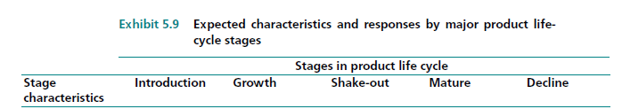
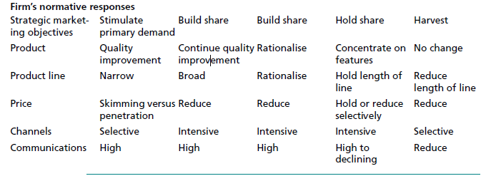
5.5.3 Strategic Implications of the Product Life Cycle
Disadvantage: Normative approach to prescribing strategies based on assumptions about the features or characteristics of each stage

